Slide 1
Unit=2
Artificial Neural Network –I (CO2)

Slide 2
Topics
Topology of Multi Layer Neural Network
Back Propagation Learning Algorithms
Limitations of MLP
Radial Basis Function Learning Algorithms
Kohenon’s Learning Algorithms
Bi-Directional Associative Memory
Applications of NEURAL NETWORK

Slide 3
Why do we need Multi Layer Neural Networks??
Some input and output patterns can be easily learned by single-layer neural networks (i.e. perception). However, these single-layer perceptron cannot learn some relatively simple patterns, such as those that are not linearly separable.
Single layer neural network can’t learn any abstract features of the input since it is limited to having only one layer. A multi-layered network overcomes this limitation as it can create internal representations and learn different features in each layer.
Each higher layer learns more and more abstract features that can be used to classify the image. Each layer finds patterns in the layer below it and it is this ability to create internal representations that are independent of outside input that gives multi-layered networks their Power.

Slide 4
Different Non-Linearly Separable Problems
Types of
Decision Regions
Exclusive-OR
Problem
Classes with
Meshed regions
Most General
Region Shapes
Structure
Single-Layer
Half Plane
Bounded By
Hyper plane
( Pattern
Association)
A
B
B
A
B
A
Two-Layer
Convex Open
Or
Closed Regions
(Pattern Mapping
A
B
B
A
B
A
Three-Layer
Arbitrary
(Complexity
Limited by No.
of Nodes)
(Pattern Classification)
A
B
B
A
B
A

Slide 5


Pattern Association

Slide 6

Pattern Mapping

Slide 7
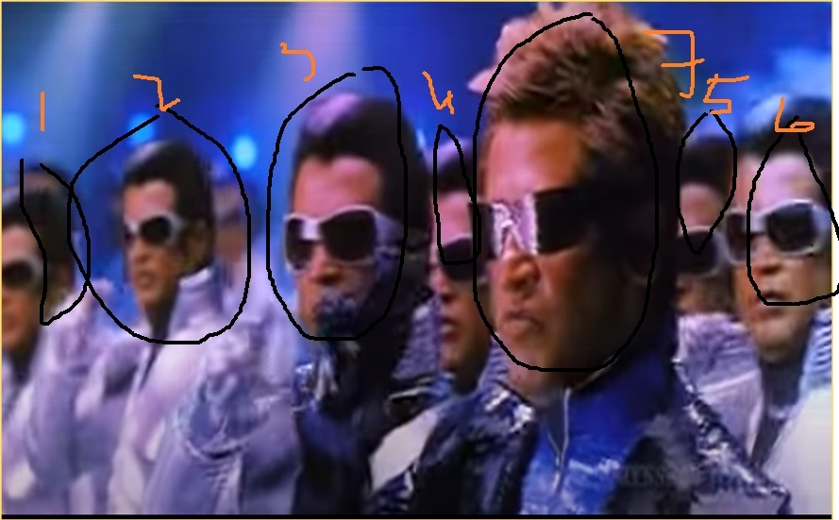
Pattern Classification

Slide 8
Multilayer Perceptrons
Architecture
Input
layer
Output
layer
Hidden Layers

Slide 9
Types of Layers
The input layer.
  Introduces input values into the network.
  No activation function or other processing.
The hidden layer(s).(Many Number of Layers)
  Perform classification of features
  Two hidden layers are sufficient to solve any problem
  Features imply more layers may be better
  activation function or other processing
The output layer.
  Functionally just like the hidden layers
  activation function or other processing
  Outputs are passed on to the world outside the neural network.

Slide 10
Multilayer Feed Forward Analysis
y
Output
z₁
z₂
…
z_{D}
Hidden Layer
x₁
x₂
x₃
…
x_{M}
Input

Slide 11
Different Levels of Abstraction
Output
y
Hidden Layer 3
c₁
c₂
…
c_{F}
Hidden Layer 2
b₁
b₂
…
b_{E}
Hidden Layer 1
a₁
a₂
…
a_{D}
Input
x₁
x₂
x₃
…
x_{M}

Slide 12
Multi-Class Output
y₁
y_{K}
…
Output
a₁
a₂
…
a_{D}
Hidden Layer
x₁
x₂
x₃
…
x_{M}
Input

Slide 13
Back Propagation Model
Backpropagation algorithm is probably the most fundamental building block in a neural network. It was first introduced in 1960s and almost 30 years later (1989) popularized by Rumelhart, Hinton and Williams in a paper called “Learning representations by back-propagating errors”.
The algorithm is used to effectively train a neural network through a method called chain rule.
Other Name of BP Model is
1) Local Gradient Method(Gradient Descent Method)
2) Generalized Delta Rule

Slide 14
Back propagation Using Gradient Descent Method
The back propagation learning algorithm can be divided into two phases:
Phase 1: Propagation
  Forward propagation of a training pattern's input through the neural network in order to generate the propagation's output activations.
  Backward propagation of the propagation's output activations through the neural network using the training pattern target in order to generate the deltas (the difference between the input and output values) of all output and hidden neurons.
Phase 2: Weight update
  Multiply its output delta and input activation to get the gradient of the weight.
  Subtract a ratio (percentage) of the gradient from the weight.

Slide 15
Back-propagation algorithm
It adjusts the weights of the NN in order to minimize the average squared error.
It adjusts the weights of the NN in order to minimize the average squared error.
It adjusts the weights of the NN in order to minimize the average squared error.
Function signals
Forward Step
Error signals
Backward Step

Slide 16
Multilayer Feed Forward Analysis
Output
y
Hidden Layer
z₁
z₂
…
z_{D}
Input
x₁
x₂
x₃
…
x_{M}

Slide 17
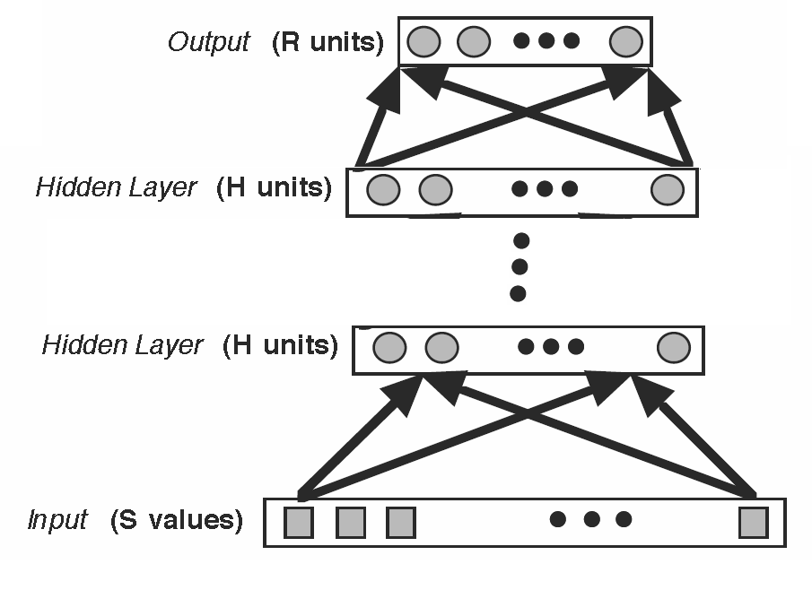
Architecture

Slide 18
Activation Function
Characteristics:
output of neuron J

Slide 19
Learning Algorithm
e_{k}(n) = d_{k}(n) - y_{k}(n)
Energy in this error
Total energy of the
output of net:
Energy of the error
produced by output
Neuron J in epoch n

Slide 20
Actual Output
Input
Activation Value of hidden Layer
Output of hidden Layer
Activation of Output Layer
Output of output Layer
Over all Output

Slide 21
Learning Algorithm(cont.’d)
Purpose
Minimizing E(n)
e_y_{k}(n) = d_{k}(n) - y_{k}(n)
Local Field

Slide 22
Learning Algorithm(cont.’d)
Chain Rule in Derivation
Local gradient

Slide 23
Learning Algorithm(cont.’d)
Negative Gradient

Slide 24
Computing Δv_{i,j} for none output layers
Problem
We don’t have error because
it is responsible for many errors
Find another way to compute δ_{j}
Chain
Rule

Slide 25
Computing Δv_{i,j} for none output layers

Slide 26
Computing Δv_{i,j} for none output layers

Slide 27
Computing Δv_{i,j} for none output layers
Negative Gradient

Slide 28
Local Gradient of neurons
if j hidden node
If k output node

Slide 29
Computing Weight correction
(Weight correction) = (Learning rate parameter)
* (local gradient)
* (input signal of previous layer Neuron)

Slide 30
Training Algorithm
Step 0 : Initialize weights
(Set to random variables with zero mean and variance one)
Step 1: While stopping condition is false do Step 2-9.
Step 2: For each training pair do Steps 3-8.
Feed forward comutation
Step 3: Each input unit(Xi,i=1,..,n) receives input signal xi and broadcasts this signal to all units in the layer above(the hidden units(

Slide 31
Training Algorithm(Cont)
Step 4: Each hidden unit (Zj j=1,…,p) sums its weighted input signals
applies its activation function to compute its output signal
and sends this signal to all units in the layer above
(outputunits)

Slide 32
Training Algorithm(Cont)
Step 5: Each output unit (Yk ,k=1,…..,m) sums its weighted input signals,
y_ink=wOk+
and applies its activation function to compute its output signal.
yk=f(y_ink).

Slide 33
Training Algorithm(Cont)
Back propagation of error:
Step 6: Each output unit ( Yk ,k=1,…,m) receives a target pattern corresponding to the input training patern
computes its error information term.
calculates its weight correction term (used to update wjk later),
calculates its bias correction term ( used to update wOk later).
and sends to units in the layer below,

Slide 34
Training Algorithm(Cont)
Step 7: Each hidden units (Zj, j=1,…,p) sums its delta inputs from units in the layer above).
O_inj=
multiplies by the derivative of its activation function to
calculate its error information term,
calculates its weight correction term(used to update vij later),
and calculates its bias correction term(used to update voj later),

Slide 35
Training Algorithm(Cont)
Update weights and biases:
Step 8: Each output units(Y_{k},k=1,….,m) updates its bias
and weights(j=0,…,p):
w_{jk}(new)=w_{jk}(old)+
Each hidden unit(Zj j=1,….,p) updates its bias and
weights(i=0,….,n):
v_{ij}(new)=v_{ij}(old)+
Step 9: Test stopping condition

Slide 36
Generalized Delta Rule
If η small ⇒ Slow rate of learning
If η large ⇒ Large changes of weights
⇒ NN can become unstable (oscillatory)
Method to overcome above drawback: include a momentum term in the delta rule
the momentum accelerates the descent in steady downhill directions
the momentum has a stabilizing effect in directions that oscillate in time.
.

Slide 37
Back propagation Using Gradient Descent
Advantages
  Relatively simple implementation
  Standard method and generally works well
Disadvantages
  Slow and inefficient
  Can get stuck in local minima resulting in sub-optimal solutions
  Back propagation can be quite sensitive to noisy data

Slide 38
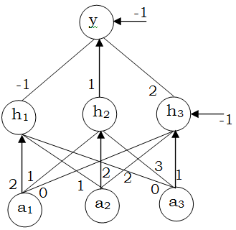
Numerical Problem
Find updated weights for input [0.6 0.8 0] and target is 0.9.
Use learning rate of 0.3. and sigmoid activation[1/1+e^{-x}] function for the given figure .

Slide 39




Numerical Problem
Input for neural net is (0.45, 0.91). Learning coefficient of net is 0.1. Train the net upto 2nditeration for target 0.63 using BPNN.
Weights and bias of hidden and output NN layers are

Slide 40
Radial Basis Function Introduction
Completely different approach by viewing the design of a neural network as a curve-fitting (approximation) problem in high-dimensional space ( i.e MLP )
A kind of supervised neural networks
Design of NN as curve-fitting problem
Learning find surface in multidimensional space best fit to training data
Generalization
Use of this multidimensional surface to interpolate the test data

Slide 41
Architecture
x₁
h₁
W₁
h₂
x₂
W₂
h₃
x₃
W₃
f(x)
W_{m}
x_{n}
h_{m}
Input layer
Hidden layer
Output layer

Slide 42
Three layers
Input layer
  Source nodes that connect to the network to its environment
Hidden layer
  Hidden units provide a set of basis function
  High dimensionality
Output layer
  Linear combination of hidden functions

Slide 43
What happens in Hidden layer?
The patterns in the input space form clusters
If the centers of these clusters are known then the distance from the cluster center can be measured
The most commonly used radial basis function is a Gaussian function
In a RBF network r is the distance from the cluster centre

Slide 44
Distance measure
The distance measured from the cluster centre is usually the Euclidean distance
For each neuron in the hidden layer, the weights represent the co-ordinates from the centre of the cluster
When the neuron receives an input pattern X, the distance is found using the equation

Slide 45
Radial basis function
h_{j}(x) = exp( -(x-c_{j})² / r_{j}² )
f(x) = ∑ w_{j} h_{j}(x)
Where c_{j} is center of a region,
r_{j} is width of the receptive field

Slide 46
RBF Networks for classification
MLP
RBF

Slide 47
Gaussian RBF φ
φ :
center
σ is a measure of how spread the curve is:
Large σ
Small σ

Slide 48
Selection of the RBF width parameter.
Not required for an MLP
smaller width
  alerting in untrained test data
Larger width
  network of smaller size & faster execution

Slide 49
Learning Strategies
Two levels of Learning
  Center and spread learning (or determination)
  Output layer Weights Learning
Make # ( parameters) small as possible
  Principles of Dimensionality

Slide 50
learning strategies
Various learning strategies
how the centers of the radial-basis functions of the network are specified.
Fixed centers selected at random
Self-organized selection of centers
Supervised selection of centers

Slide 51
Fixed centers selected at random(1)
learning strategies
Fixed RBFs of the hidden units
The locations of the centers may be chosen randomly from the training data set.
We can use different values of centers and widths for each radial basis function -> experimentation with training data is needed.

Slide 52
Fixed centers selected at random(2)
learning strategies
Only output layer weight is need to be learned.
Obtain the value of the output layer weight by pseudo-inverse method
Main problem
  Require a large training set for a satisfactory level of performance

Slide 53
Self-organized selection of centers(1)
learning strategies
Hybrid learning
  self-organized learning to estimate the centers of RBFs in hidden layer
  supervised learning to estimate the linear weights of the output layer
Self-organized learning of centers by means of clustering.
Supervised learning of output weights by LMS algorithm.

Slide 54
Self-organized selection of centers(2)
learning strategies
k-means clustering
  Initialization
  Sampling
  Similarity matching
  Updating
  Continuation

Slide 55
Supervised selection of centers
learning strategies
All free parameters of the network are changed by supervised learning process.
Error-correction learning using LMS algorithm.

Slide 56
Learning formula
learning strategies
Linear weights (output layer)
Positions of centers (hidden layer)
Spreads of centers (hidden layer)

Slide 57
MLP vs RBFN
MLP | RBF
Can have any number of hidden layer | Can have only one hidden layer
Can be fully or partially connected | Has to be mandatorily completely connected
Processing nodes in different layers shares a common neural model | Hidden nodes operate very differently and have a different purpose
Argument of hidden function activation function is the inner product of the inputs and the weights | The argument of each hidden unit activation function is the distance between the input and the weights
Trained with a single global supervised algorithm | RBF networks are usually trained one later at a time
Training is slower compared to RBF | Training is comparitely faster than MLP
After training MLP is much faster than RBF | After training RBF is much slower than MLP

Slide 58
Kohonen SOM (Self Organizing Maps)
It Consists of only 2 layers( Input and Output Layer)
We can include additional structure in the network so that the net is forced to make a decision as to which one unit will respond.
The mechanism by which it is achieved is Neural Networks based on Competition
It can be used in unsupervised learning.
A common use for unsupervised learning is clustering based neural networks.
In a clustering net, there are as many units as the input vector has components.
Every output unit represents a cluster and the number of output units limit the number of clusters.
During the training, the network finds the best matching output unit to the input vector.
The weight vector of the winner is then updated according to learning algorithm

Slide 59
Kohonen SOM (Self Organizing Maps)
Since it is unsupervised environment, so the name is Self Organizing Maps.
Self Organizing NNs are also called Topology Preserving Maps which leads to the idea of neighborhood of the clustering unit.
During the self-organizing process, the weight vectors of winning unit and its neighbors are updated.

Slide 60
Kohonen SOM (Self Organizing Maps)
Normally, Euclidean distance measure is used to find the cluster unit whose weight vector matches most closely to the input vector.
For a linear array of cluster units, the neighborhood of radius R around cluster unit J consists of all units j such that:

Slide 61
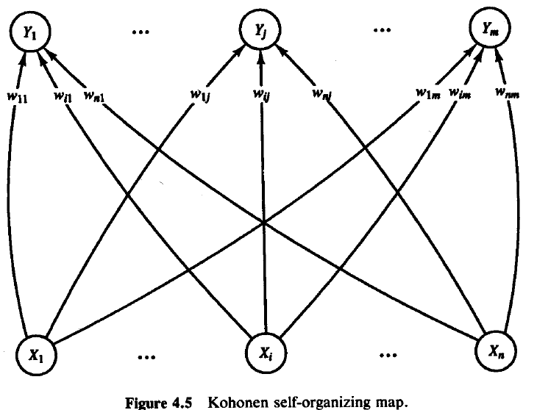
Kohonen SOM (Self Organizing Maps)
Architecture of SOM

Slide 62
KOHONEN SELF ORGANIZING MAPS
Architecture
neuron i
Kohonen layer
w_{i}
Winning neuron
Input vector X
X=[x₁,x₂,…x_{n}] ∈ R^{n}
w_{i}=[w_{i1},w_{i2},…,w_{in}] ∈ R^{n}

Slide 63
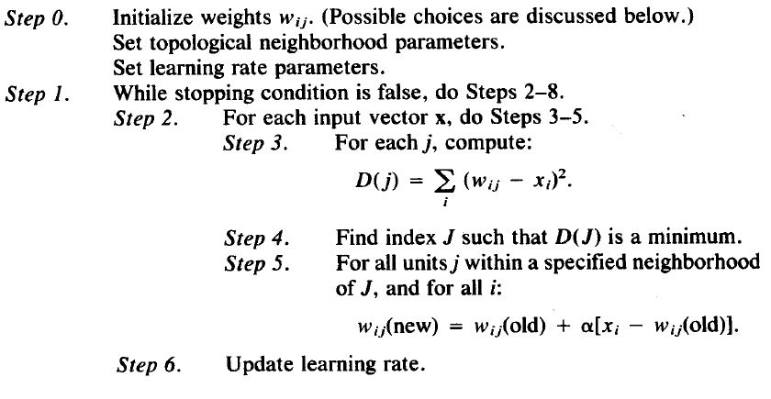
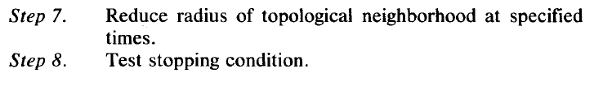
Algorithm:

Slide 64
Kohonen SOM (Self Organizing Maps)
  Radius and learning rates may be decreased after each epoch.
  Learning rate decrease may be either linear or geometric.

Slide 65
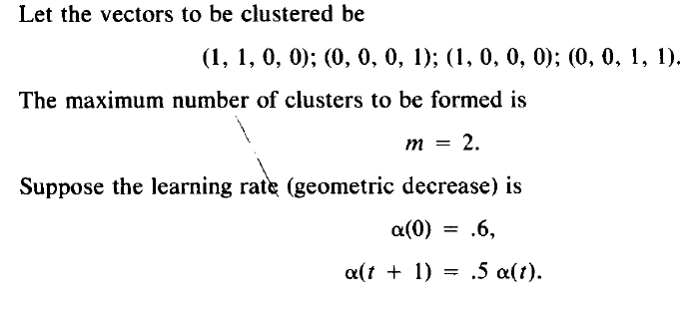
Kohonen SOM (Self Organizing Maps)
Example

Slide 66
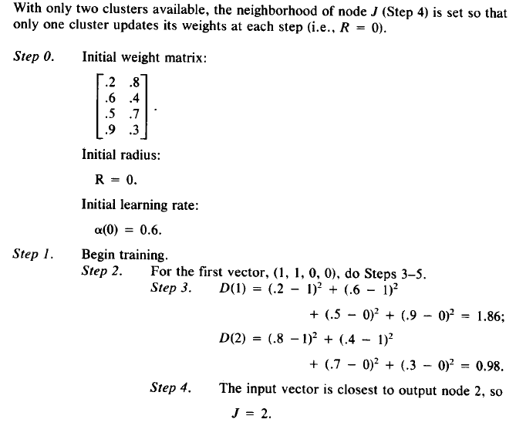
Kohonen SOM (Self Organizing Maps)

Slide 67
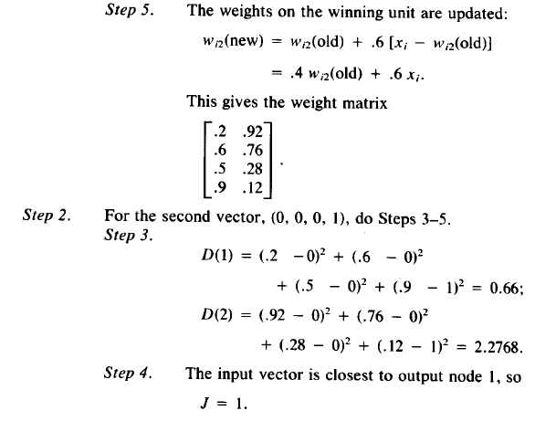
Kohonen SOM (Self Organizing Maps)

Slide 68

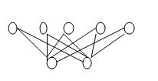
Problem
A Kohenen’s Self organizing map is shown with weights
a) Using the Square Euclidean distance find the output unit that is closest to the input vector (0.3 0.4)
b) Using a learning rate of 0.3 find the new weights for unit
c) Find new weights for if they are allowed to learn.

Slide 69
Associative-Memory Networks
Motivation
  Human ability to retrieve information from applied associated stimuli
    Ex. Recalling one’s relationship with another after not seeing them for several years despite the other’s physical changes (aging, facial hair, etc.)
    Enhances human awareness and deduction skills and efficiently organizes vast amounts of information
  Why not replicate this ability with computers?
    Ability would be a crucial addition to the Artificial Intelligence Community in developing rational, goal oriented, problem solving agents
One realization of Associative Memories are Contents Addressable Memories (CAM)

Slide 70
Associative-Memory Networks
Used for memory retrieval, returning one pattern given another. There are three types of associative memory
Hetero associative(HAM): Mapping from X to Y s.t. if an arbitrary vector is closer to Xi than to any other Xj, the vector Yi associated with Xi is returned.
Auto associative(AAM): Same as above except that Xi = Yi for all exemplar pairs. Useful in retrieving a full pattern from a degraded one.

Slide 71
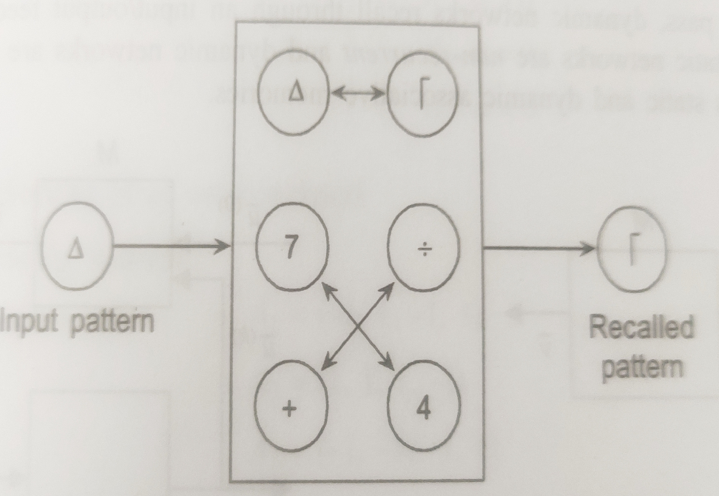
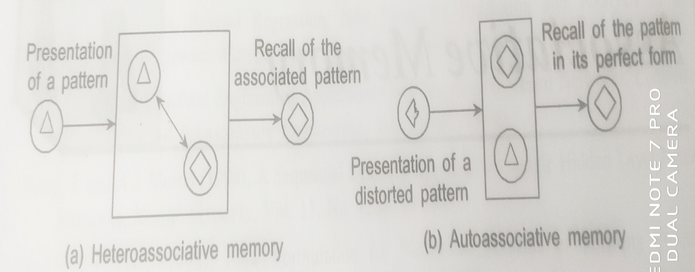

Slide 72
Bi-Directional Associative Memory
A bi-directional associative memory (BAM) network is one with two fully connected layers, in which the links are all bi-directional. There can also be a feedback link connecting a node to itself. A BAM network may be trained, or its weights may be worked out in advance. It is used to map a set of vectors Xi (input layer) to a set of vectors Yi (output layer).

Slide 73
Associative-Memory Networks
Input: Pattern (often noisy/corrupted)
Output: Corresponding pattern (complete / relatively noise-free)
Process
  Load input pattern onto core group of highly-interconnected neurons.
  Run core neurons until they reach a steady state.
  Read output off of the states of the core neurons.
Inputs
Outputs
Input: (1 0 1 -1 -1)
Output: (1 -1 1 -1 -1)

Slide 74
Associative Network Types
1. Auto-associative: X = Y
*Recognize noisy versions of a pattern
2. Hetero-associative Bidirectional: X <> Y
BAM = Bidirectional Associative Memory
*Iterative correction of input and output

Slide 75
Associative Network Types (2)
3. Hetero-associative Input Correcting: X <> Y
*Input clique is auto-associative => repairs input patterns
4. Hetero-associative Output Correcting: X <> Y
*Output clique is auto-associative => repairs output patterns

Slide 76
Hebb’s Rule
Connection Weights ~ Correlations
``When one cell repeatedly assists in firing another, the axon of the first cell
develops synaptic knobs (or enlarges them if they already exist) in contact
with the soma of the second cell.” (Hebb, 1949)
In an associative neural net, if we compare two pattern components (e.g. pixels)
within many patterns and find that they are frequently in:
a) the same state, then the arc weight between their NN nodes should be positive
b) different states, then ” ” ” ” negative
Matrix Memory:
The weights must store the average correlations between all pattern components
across all patterns. A net presented with a partial pattern can then use the correlations
to recreate the entire pattern.

Slide 77
Correlated Field Components
Each component is a small portion of the pattern field (e.g. a pixel).
In the associative neural network, each node represents one field component.
For every pair of components, their values are compared in each of several patterns.
Set weight on arc between the NN nodes for the 2 components ~ avg correlation.
a
a
??
??
b
b
Avg Correlation
w_{ab}
a
b

Slide 78
Quantifying Hebb’s Rule
Compare two nodes to calc a weight change that reflects the state correlation:
Auto-Association:
* When the two components are the same (different),
increase (decrease) the weight
i = input component
o = output component
Hetero-Association:
Ideally, the weights will record the average correlations across all patterns:
Auto:
Hetero:
Hebbian Principle: If all the input patterns are known prior to retrieval time,
then init weights as:
Auto:
Hetero:
Weights = Average Correlations

Slide 79
Hebb Rule for Pattern Association
Architecture
x₁
w₁₁
Y1
x_{n}
y_{m}
w_{nm}

Slide 80
Hebb Rule for Pattern Association
1. set w_{ij} = 0 1 <= i <= n, 1 <= j <= m
for each training pair s:t
2. x_{i} = s_{i}
3. y_{j} = t_{j}
4. w_{ij}(new) = w_{ij}(old) + x_{i}y_{j}

Slide 81
Auto-Associative Memory
Auto-associative memories are content based memories which can recall a stored sequence when they are presented with a fragment or a noisy version of it.
They are very effective in de-noising the input or removing interference from the input which makes them a promising first step in solving the cocktail party problem.
The simplest version of auto-associative memory is linear associate which is a 2-layer feed-forward fully connected neural network where the output is constructed in a single feed-forward computation. The figure below illustrates its basic connectivity

Slide 82
Matrix Alternative or linear Associative
s₁ = (1 -1 -1), s₂ = (-1 1 1)
t₁ = (1 -1), t₂ = (-1 1)
1 -1 1 -1 2 -2
-1 1 -1 1 = -2 2
-1 1 -2 2

Slide 83
Example
s₁ = (1 -1 -1), s₂ = (-1 1 1)
t₁ = (1 -1), t₂ = (-1 1)
w₁₁ = 1*1 + (-1)(-1) = 2
w₁₂ = 1*(-1) + (-1)1 = -2
w₂₁ = (-1)1+ 1(-1) = -2
w₂₂ = (-1)(-1) + 1(1) = 2
w₃₁ = (-1)1 + 1(-1) = -2
w₃₂ = (-1)(-1) + 1*1 = 2

Slide 84
Final Network
f(y_{in}) = 1 if y_{in} > 0, 0 if y_{in} = 0, else -1
x₁
2
-2
y₁
-2
x₂
2
y₂
-2
x₃
2

Slide 85
Exercises
What happens if (-1 -1 -1) is tested? This vector has one mistake.
What happens if (0 -1 -1) is tested? This vector has one piece of missing data.
Show an example of training data that is not learnable. Show the learned network.

Slide 86
Storage Capacity(AAM)
2 vectors (1 1 1), (-1 -1 -1)
Recall is perfect
1 -1 1 1 1 0 2 2
1 -1 -1 -1 -1 = 2 0 2
1 -1 2 2 0

Slide 87
Evaluation
What happens if (1 1 1) is presented?
What happens if (0 1 1) is presented?
What happens if (0 0 1) is presented?
What happens if (-1 1 1) is presented?
What happens if (-1 -1 1) is presented?
Why are the diagonals set to 0?

Slide 88
Storage Capacity(AAM)
3 vectors: (1 1 1), (-1 -1 -1), (1 -1 1)
Recall is no longer perfect
1 -1 1 1 1 1 0 1 3
1 -1 -1 -1 -1 -1 = 1 0 1
1 -1 1 1 -1 1 3 1 0

Slide 89
Testing Procedure
1. initialize weights using Hebb learning
2. for each test vector do
3. set x_{i} = s_{i}
4. calculate t_{i}
5. set s_{i} = t_{i}
6. go to step 4 if the s vector is new

Slide 90
Exercises
1 piece of missing data: (0 1 -1)
2 pieces of missing data: (0 0 -1)
3 pieces of missing data: (0 0 0)
1 mistake: (-1 1 -1)
2 mistakes: (-1 -1 -1)

Slide 91
Matrix Representation
Let X = matrix of input patterns, where each ROW is a pattern. So x_{k,i} = the ith bit of the kth pattern.
Let Y = matrix of output patterns, where each ROW is a pattern. So y_{k,j} = the jth bit of the kth pattern.
Then, avg correlation between input bit i and output bit j across all patterns is:
1/P (x_{1,i}y_{1,j} + x_{2,i}y_{2,j} + … + x_{p,i}y_{p,j}) = w_{i,j}
To calculate all weights:
Hetero Assoc: W = X^{T}Y
Auto Assoc: W = X^{T}X
X
X^{T}
Dot product
Y
P1 P2 Pp
X_{1,i}
X_{2,i}
X_{p,i}
Out P1: y_{1,1}.. y_{1,j}……y_{1,n}
In Pattern 1: x_{1,1}..x_{1,n}
..
Out P2: y_{2,1}.. y_{2,j}……y_{2,n}
In Pattern 2: x_{2,1}..x_{2,n}
:
:
Out P3: y_{p,1}.. y_{p,j} ……y_{p,n}
In Pattern p: x_{1,1}..x_{1,n}

Slide 92
Auto-Associative Memory
1. Auto-Associative Patterns to Remember
3. Retrieval
Comp/Node value legend:
dark (Red) with x => +1
Light (red) w/o x => -1
light (Blue ) => 0
1
2
1
2
1
2
3
4
3
4
3
4
2. Distributed Storage of All Patterns:
1
2
1
2
3
4
-1
1
1
2
3
4
3
4
1 node per pattern unit
Fully connected: clique
Weights = avg correlations across
all patterns of the corresponding units
1
2
3
4

Slide 93
Hetero-Associative Memory
1. Hetero-Associative Patterns (Pairs) to Remember
3. Retrieval
1
1
a
a
2
2
b
b
3
3
2. Distributed Storage of All Patterns:
1
-1
a
1
2
b
3
1 node per pattern unit for X & Y
Full inter-layer connection
Weights = avg correlations across
all patterns of the corresponding units

Slide 94
Bi-Directional Associative Memory
Apply an initial vector pair (X,Y) to the processing elements. X is the pattern we wish to retrieve and Y is random.
Propagate the information from the X layer to the Y layer and update the values at the Y layer.
Send the information back to the X layer, updating those nodes.
The basic idea behind the BAM is to store pattern pairs so that when n-dimensional vector X from set A is presented as input, the BAM recalls m-dimensional vector Y from set B, but when Y is presented as input, the BAM recalls X
Continue until equilibrium is reached.

Slide 95
Bi-Directional Associative Memory

Slide 96
Bi-Directional Associative Memory
To develop the BAM, we need to create a correlation matrix for each pattern pair we want to store. The correlation matrix is the matrix product of the input vector X, and the transpose of the output vector Y^{T}. The BAM weight matrix is the sum of all correlation matrices, that is,
where M is the number of pattern pairs to be stored in the BAM.

Slide 97
Stability and storage capacity of the BAM
The BAM is unconditionally stable. This means that any set of associations can be learned without risk of instability.
The maximum number of associations to be stored in the BAM should not exceed the number of neurons in the smaller layer.
The more serious problem with the BAM is incorrect convergence. The BAM may not always produce the closest association. In fact, a stable association may be only slightly related to the initial input vector.
https://www.youtube.com/watch?v=rpwrJOzWOws

Slide 98
Advantages of BAM
Fast Training Network
Staright forward operation
Bidirectional Data Flow
Application of BAM
Associative Memorization
Pattern Recognization
Noise Suppression

Slide 99
Things to Remember
Auto-Associative -vs- Hetero-associative
  Wide variety of net topologies
  All use Hebbian Learning => weights ~ avg correlations
One-shot -vs- Iterative Retrieval
  Iterative gives much better error correction.
Asynchronous -vs- Synchronous state updates
  Synchronous updates can easily lead to oscillation
  Asynchronous updates can quickly find a local optima (attractor)
    Update order can determine attractor that is reached.
Pattern Retrieval = Search in node-state space.
  Spurious patterns are hard to avoid, since many are attractors also.
  Stochasticity helps jiggle out of local minima.
  Memory load increase => recall error increase.
Associative -vs- Feed-Forward Nets
  Assoc: Many - 1 mapping Feed-Forward: many-many mapping
  Backprop is resource-intensive, while Hopfield iterative update is O(n)
  Gradient-Descent on an Error -vs- Energy Landscape:
    Backprop => arc-weight space Hopfield => node-state space

Slide 100

Bidirectional associative memory is a heteroassociative, content-addressable memory consisting of two layers. It uses the forward and backward information. flow to produce an associative search for stored stimulus-response association (Kosko 1987, 1988). Consider that stored in the memory are p vector association pairs known as

Slide 101
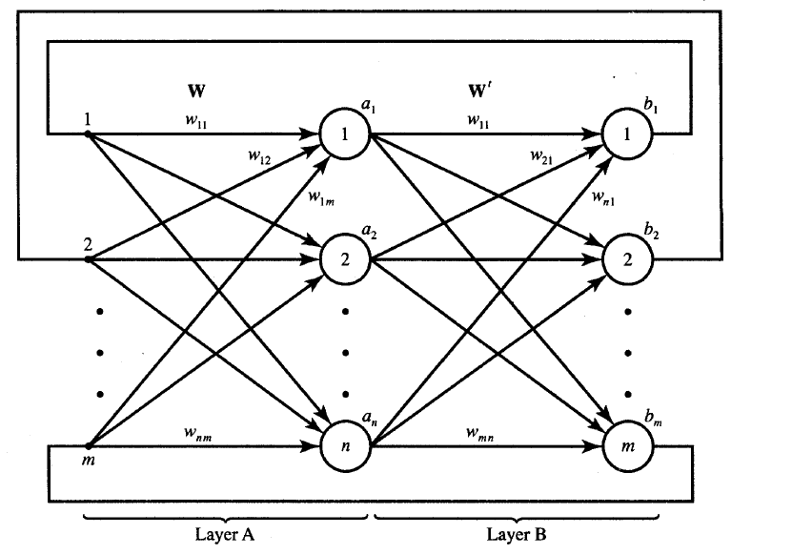

Slide 102
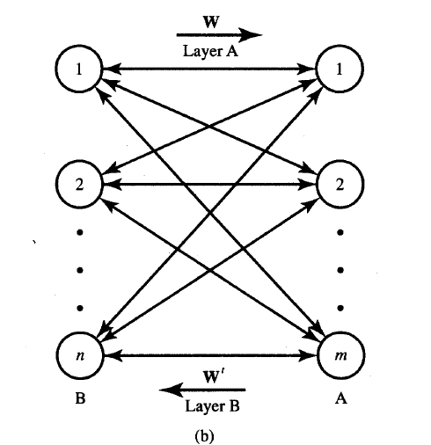

Slide 103
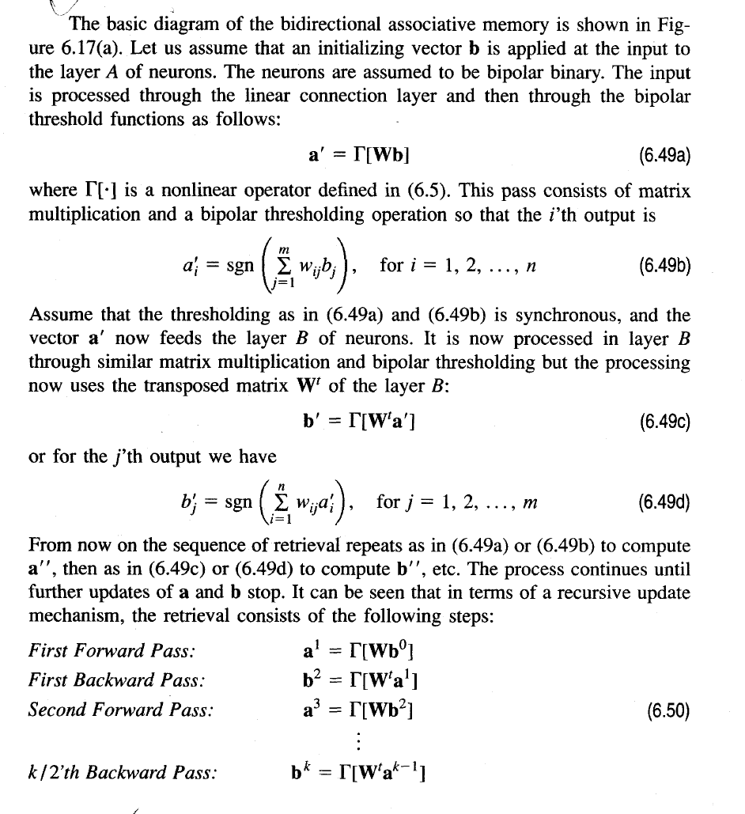

Slide 104
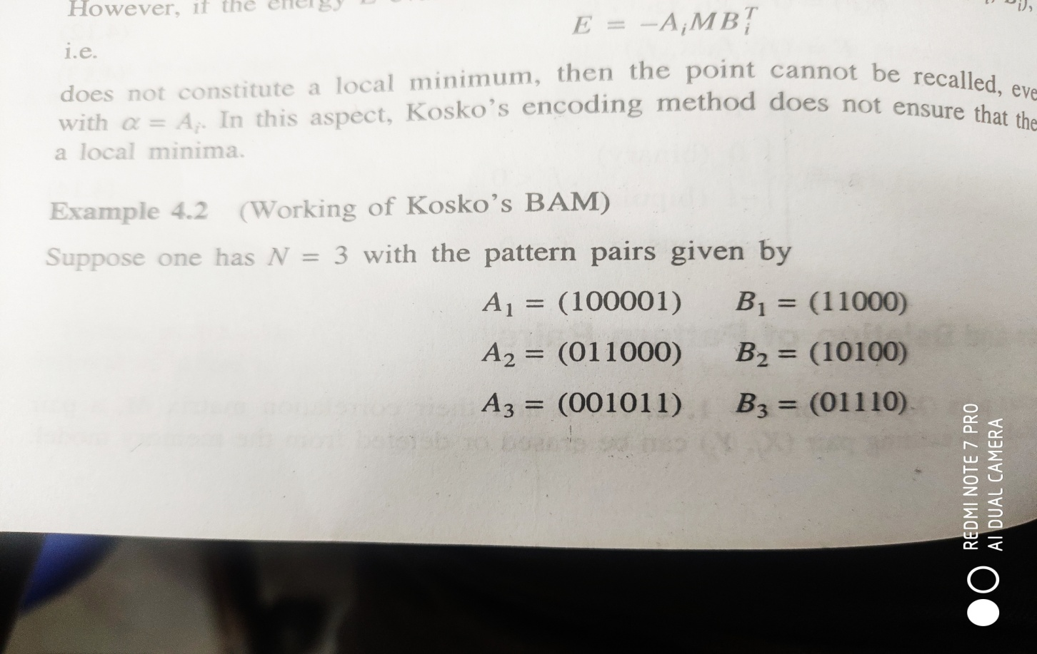

Slide 105


